Slide 1
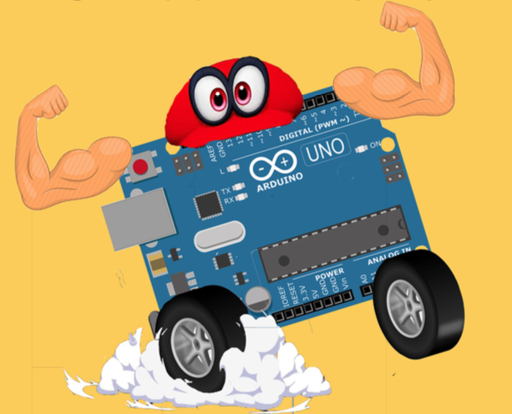
Muscle Car Summer Camp
GEAR UP
Summer 2018

Slide 2
Overview of Program
Design and build your own muscle car to take home!
Lectures will be given and related activities/assignments will be done.
SAT & ACT Prep - Feel free to take notes as we will do practice tests!
Muscle Car: Arduino-controlled device programmed to transmit musculoskeletal impulses into directional driving power.
Encompasses:
Electrical Engineering Mechanical Engineering
Biomedical Engineering Computer Science

Slide 3
What is an engineer?
a person who designs, builds, or maintains engines, machines, or public works
Google
Engineering is the creative application of science, mathematical methods, and empirical evidence to the innovation, design, construction, operation and maintenance of structures, machines, materials, devices, systems, processes, and organizations
Wikipedia

Slide 4












Some problems solved by engineers

Slide 5
Tuesday, 06/12/2018 - Agenda
Week by week breakdown
Goals
Teams
Rules
Preliminary Quiz
Preliminary Survey
Lecture
Activities

Slide 6
Week by Week Breakdown
Week 1: CAD & 3D Printing
Week 2: Electrical Componentry & Programming
Week 3: Construction, Soldering, & Prototyping
Week 4: Troubleshooting & Competition

Slide 7
Goals
Gain and/or enhance skills in engineering
Programming, Design, Prototyping, Problem-Solving, etc.
Guide to an area of interest within the STEM field
Helping you narrow down choices for a major in college
Build a multi-disciplinary project from start to finish.
Prepare for SAT & ACT tests

